Slide 1
Learning, Planning & Dyna-Q
AINT351 Machine Learning
Ian Howard and Torbjorn Dahl

Slide 2
The Story So Far
Introduction to ML
Classification with Decision Trees
Cross-Validation
Reinforcement Learning and Dynamic Programming
MC methods and TD learning *
Learning, Planning and Dyna-Q
* Planned release of practical P2.2

Slide 3
The Remaining Weeks
Generalisation and function approximation
POMDPs, Belief States and the Witness Algorithm
Instance-based state identification and NSM**
Connectionist POMDP methods
Point-Based Value Iteration and SARSOP
Hierarchical Methods
** Planned practical P2.3 hand-out

Slide 4
Methods for known Transition Functions
Policy Evaluation
Finds the value of a given policy
Value Iteration
Finds the optimal policy assuming greedy action selection

Slide 5
Model Free Methods
Approximate value functions from experience
Do not model the transition function explicitly

Slide 6
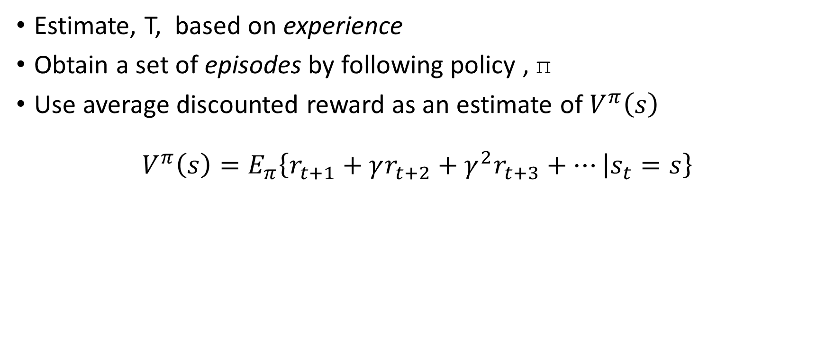
Monte-Carlo Methods
Estimate, T, based on experience
Obtain a set of episodes by following policy , π
Use average discounted reward as an estimate of $V^{π}\left(s\right)$
$$V^{π}\left(s\right)=E_{π}\left\{r_{t+1}+γr_{t+2}+γ^{2}r_{t+3}+… | s_{t}=s\right\}$$

Slide 7
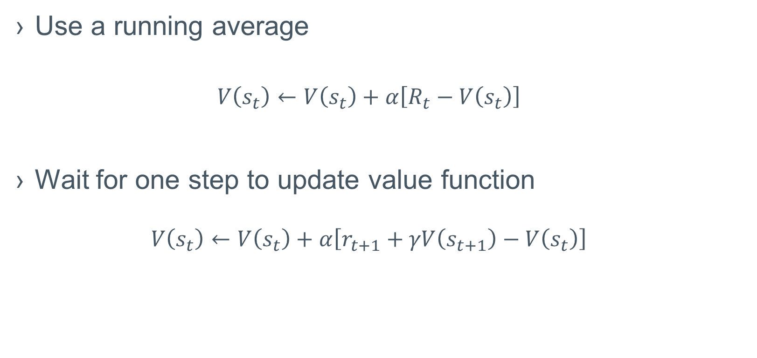
TD Prediction
Use a running average
$$V\left(s_{t}\right)←V\left(s_{t}\right)+α\left[R_{t}−V\left(s_{t}\right)\right]$$
Wait for one step to update value function
$$V\left(s_{t}\right)←V\left(s_{t}\right)+α\left[r_{t+1}+γV\left(s_{t+1}\right)−V\left(s_{t}\right)\right]$$

Slide 8
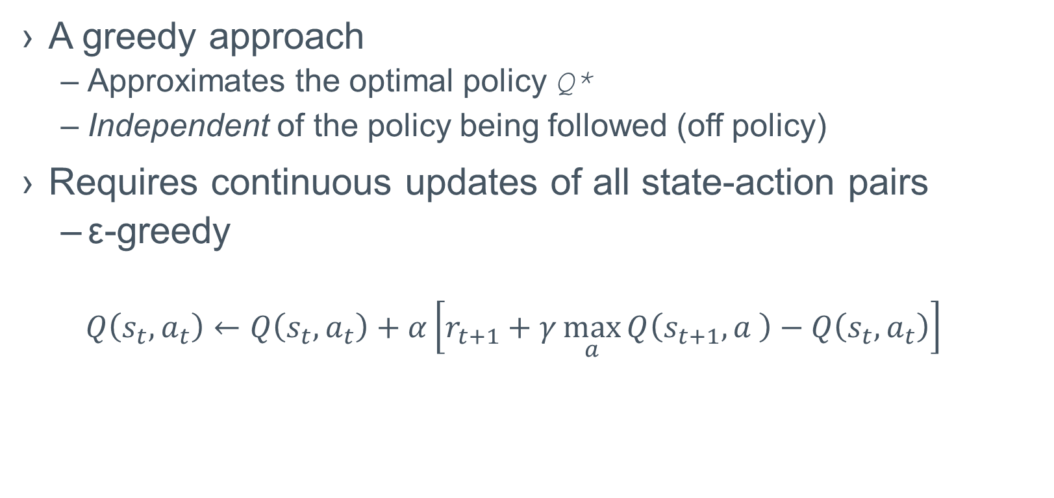
Q-Learning
A greedy approach
Approximates the optimal policy Q*
Independent of the policy being followed (off policy)
Requires continuous updates of all state-action pairs
ε-greedy
$$Q\left(s_{t},a_{t}\right)←Q\left(s_{t},a_{t}\right)+α\left[r_{t+1}+γ\max_{a}{Q\left(s_{t+1},a \right)−Q\left(s_{t},a_{t}\right)}\right]$$

Slide 9
Eligibility Traces
A record of the most recently experienced states, actions and rewards
A sequence of tuples <s, a, r> in chronological order
Updated on each step if the algorithm
Our basic mechanism for temporal credit assignment
Spreading new information about state-action values through the value function
A bridge between MC and TD

Slide 10
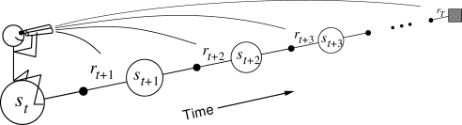
Forward View
Decide how to update the value of each state by looking at future rewards and states
Theoretical
Not implementable as it is acausal

Slide 11
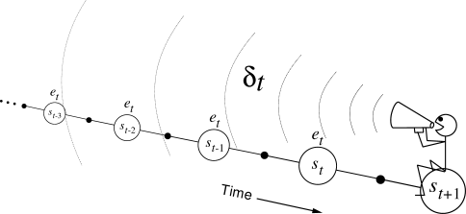
Backward View
Mechanistic
Implementable
Traces correspond closely to short-term memory
Our value function and transition function are long-term memory

Slide 12
Mixed Updates
MC-methods backed up values from the terminal
TD/Q learning backed up values across one step
We can back up arbitrary many steps in between
We can also back up many different steps
Must weigh them to maintain stats

Slide 13
Models
Anything that can be used to predict results of actions
Simulated experience
Distribution models
Provide probability distributions over successor states
Sample models
Returns a single successor state drawn from the appropriate probability distribution

Slide 14
Planning
Interpreted differently in different areas
In RL, any process that
Takes a model
Produces or improves a policy

Slide 15
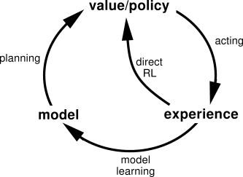
Integrating Learning, Planning and Acting
Take actions
Update value functions
Update model
Plan (simulate experience)
Update value functions

Slide 16
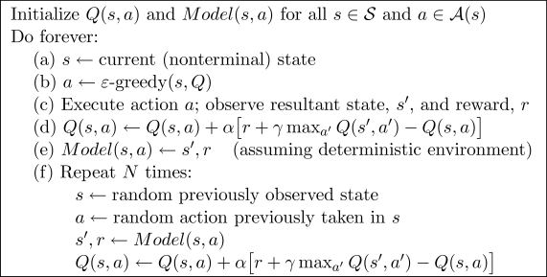
The Dyna-Q Algorithm

